Slide 1
Lab Molar volume
To calculate the volume of 1 mole of a gas
(this is how Chemists determined that 1 mole= 22.4l)

Slide 2
Lab :Molar Volume needed info
Video explanation Lab Molar volume
Lab Molar Volume Report worksheet

Slide 3
Balance single replacement reaction
Mg + HCl →
On report worksheet

Slide 4
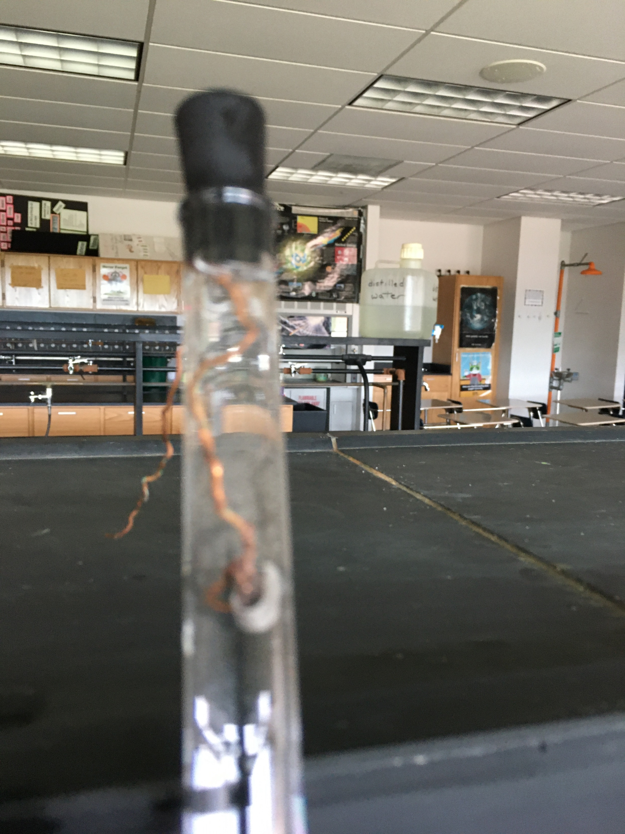
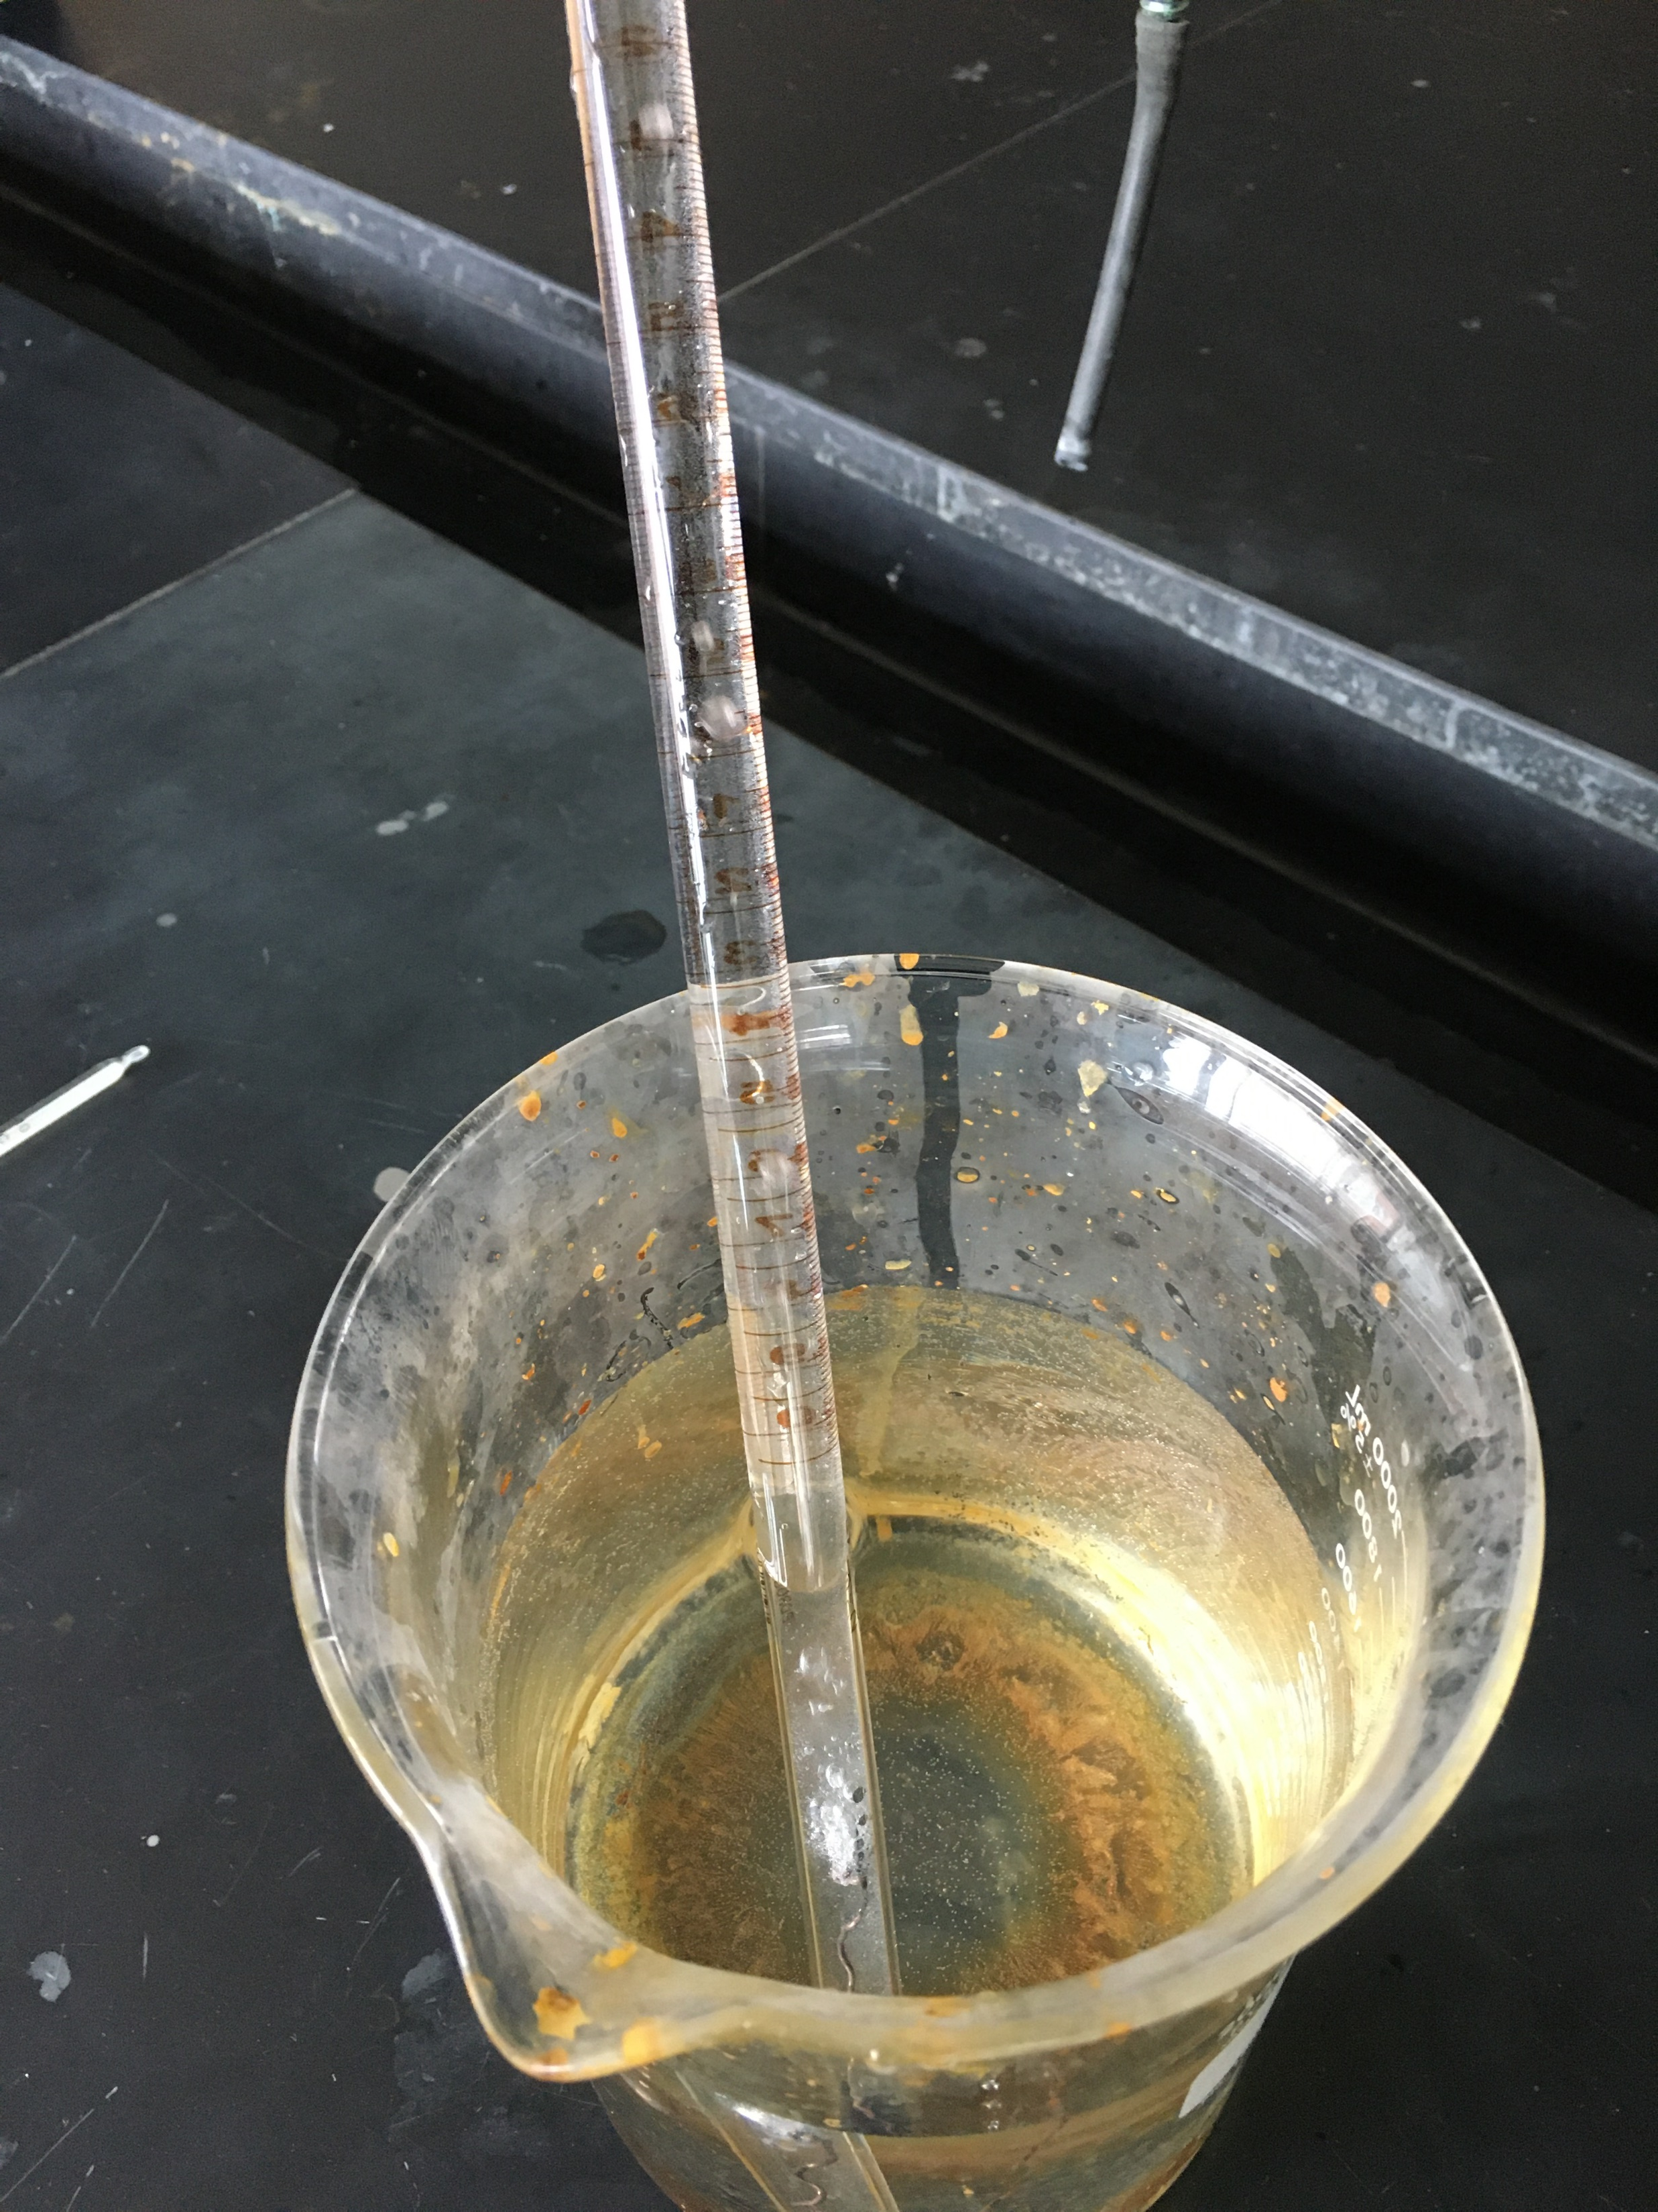
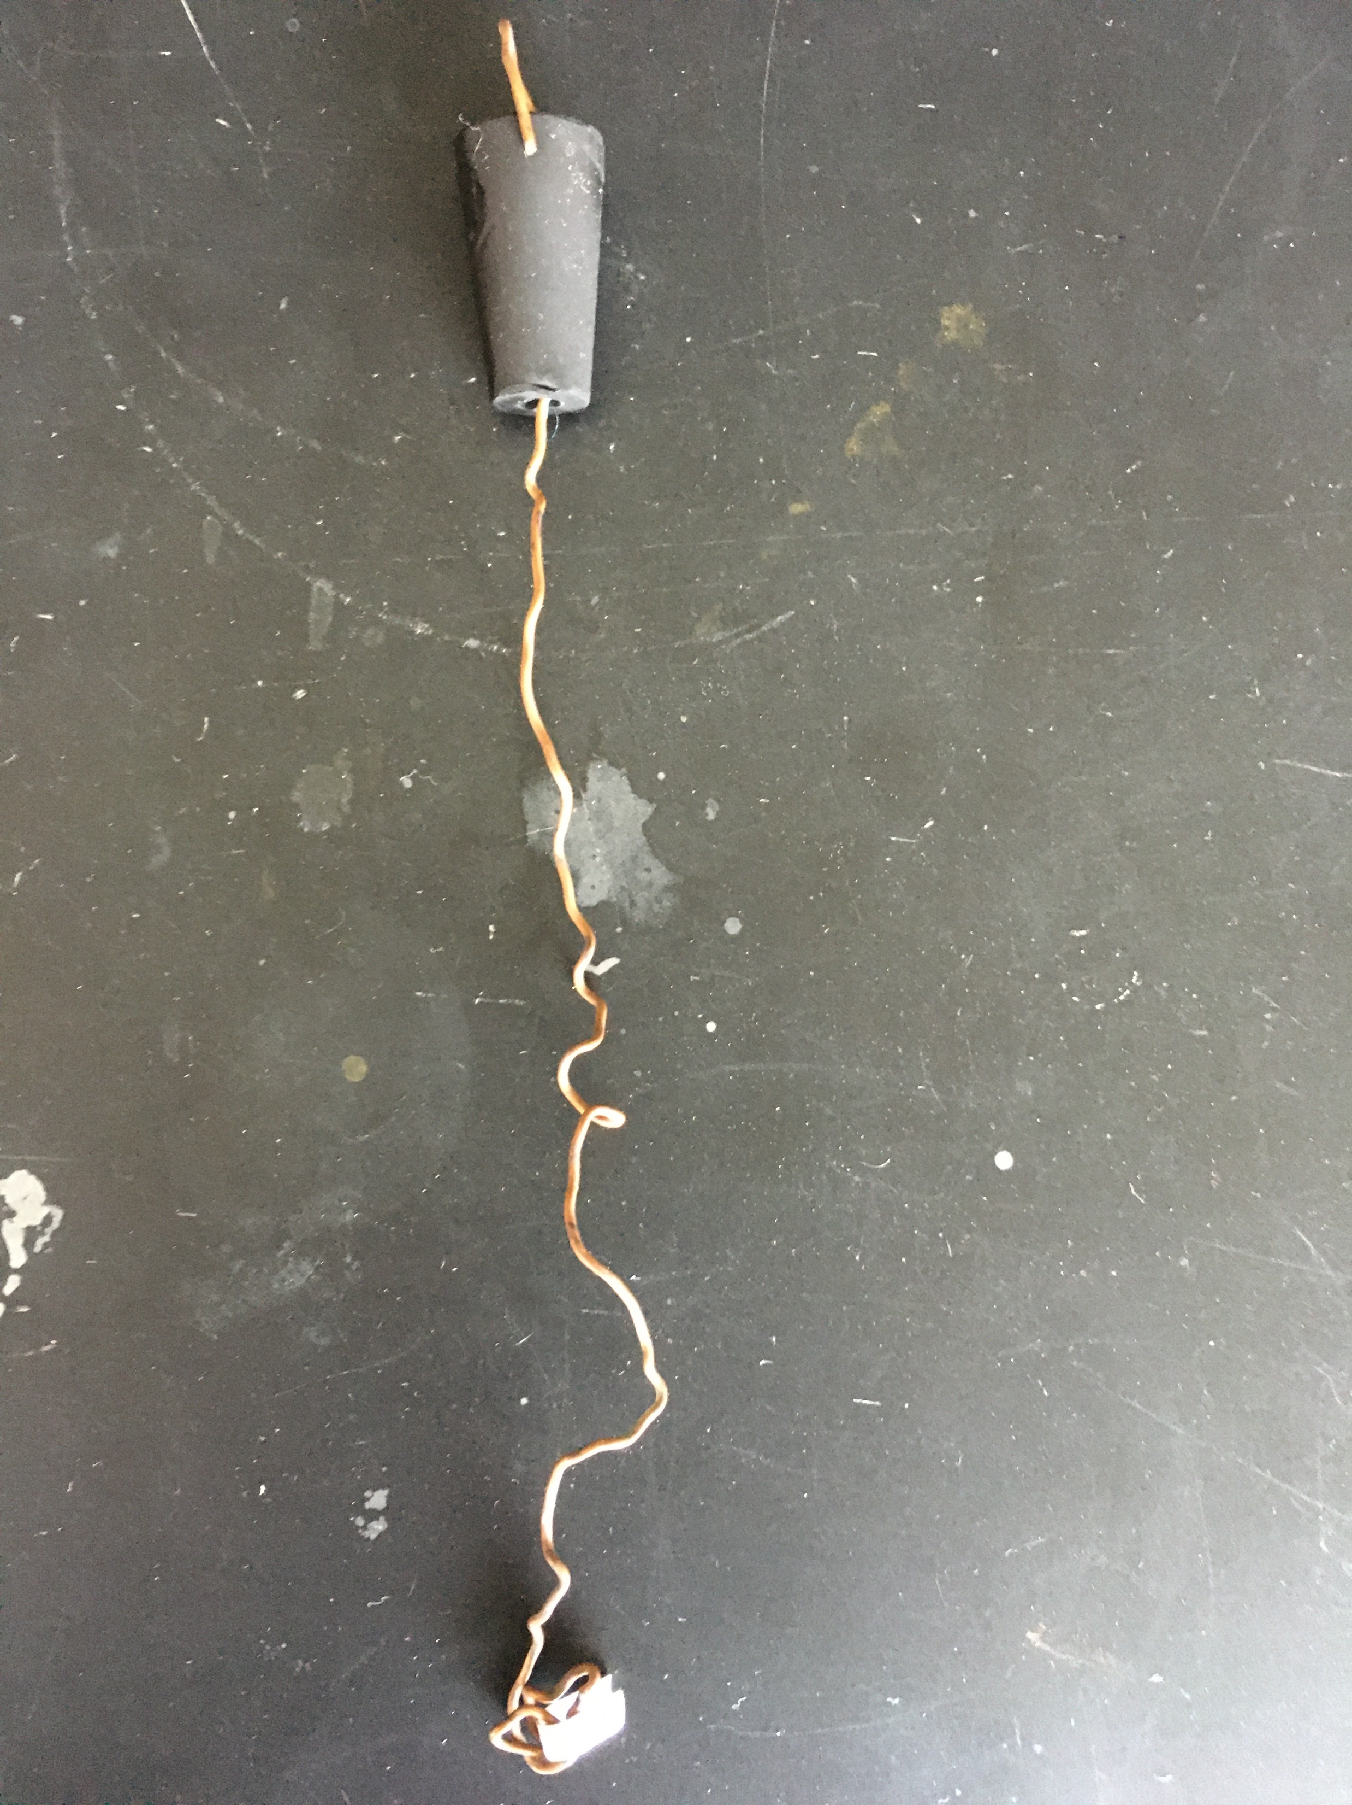
Gas collection set up

Slide 5
Validity of Assumptions – Think about gas relationships
Write if you think it is a good or bad assumption on your lab report worksheet
1. All Mg reaction
. 2. Pressure inside eudiometer is same as room pressure
3. Temperature inside eudiometer is same as room temperature

Slide 6
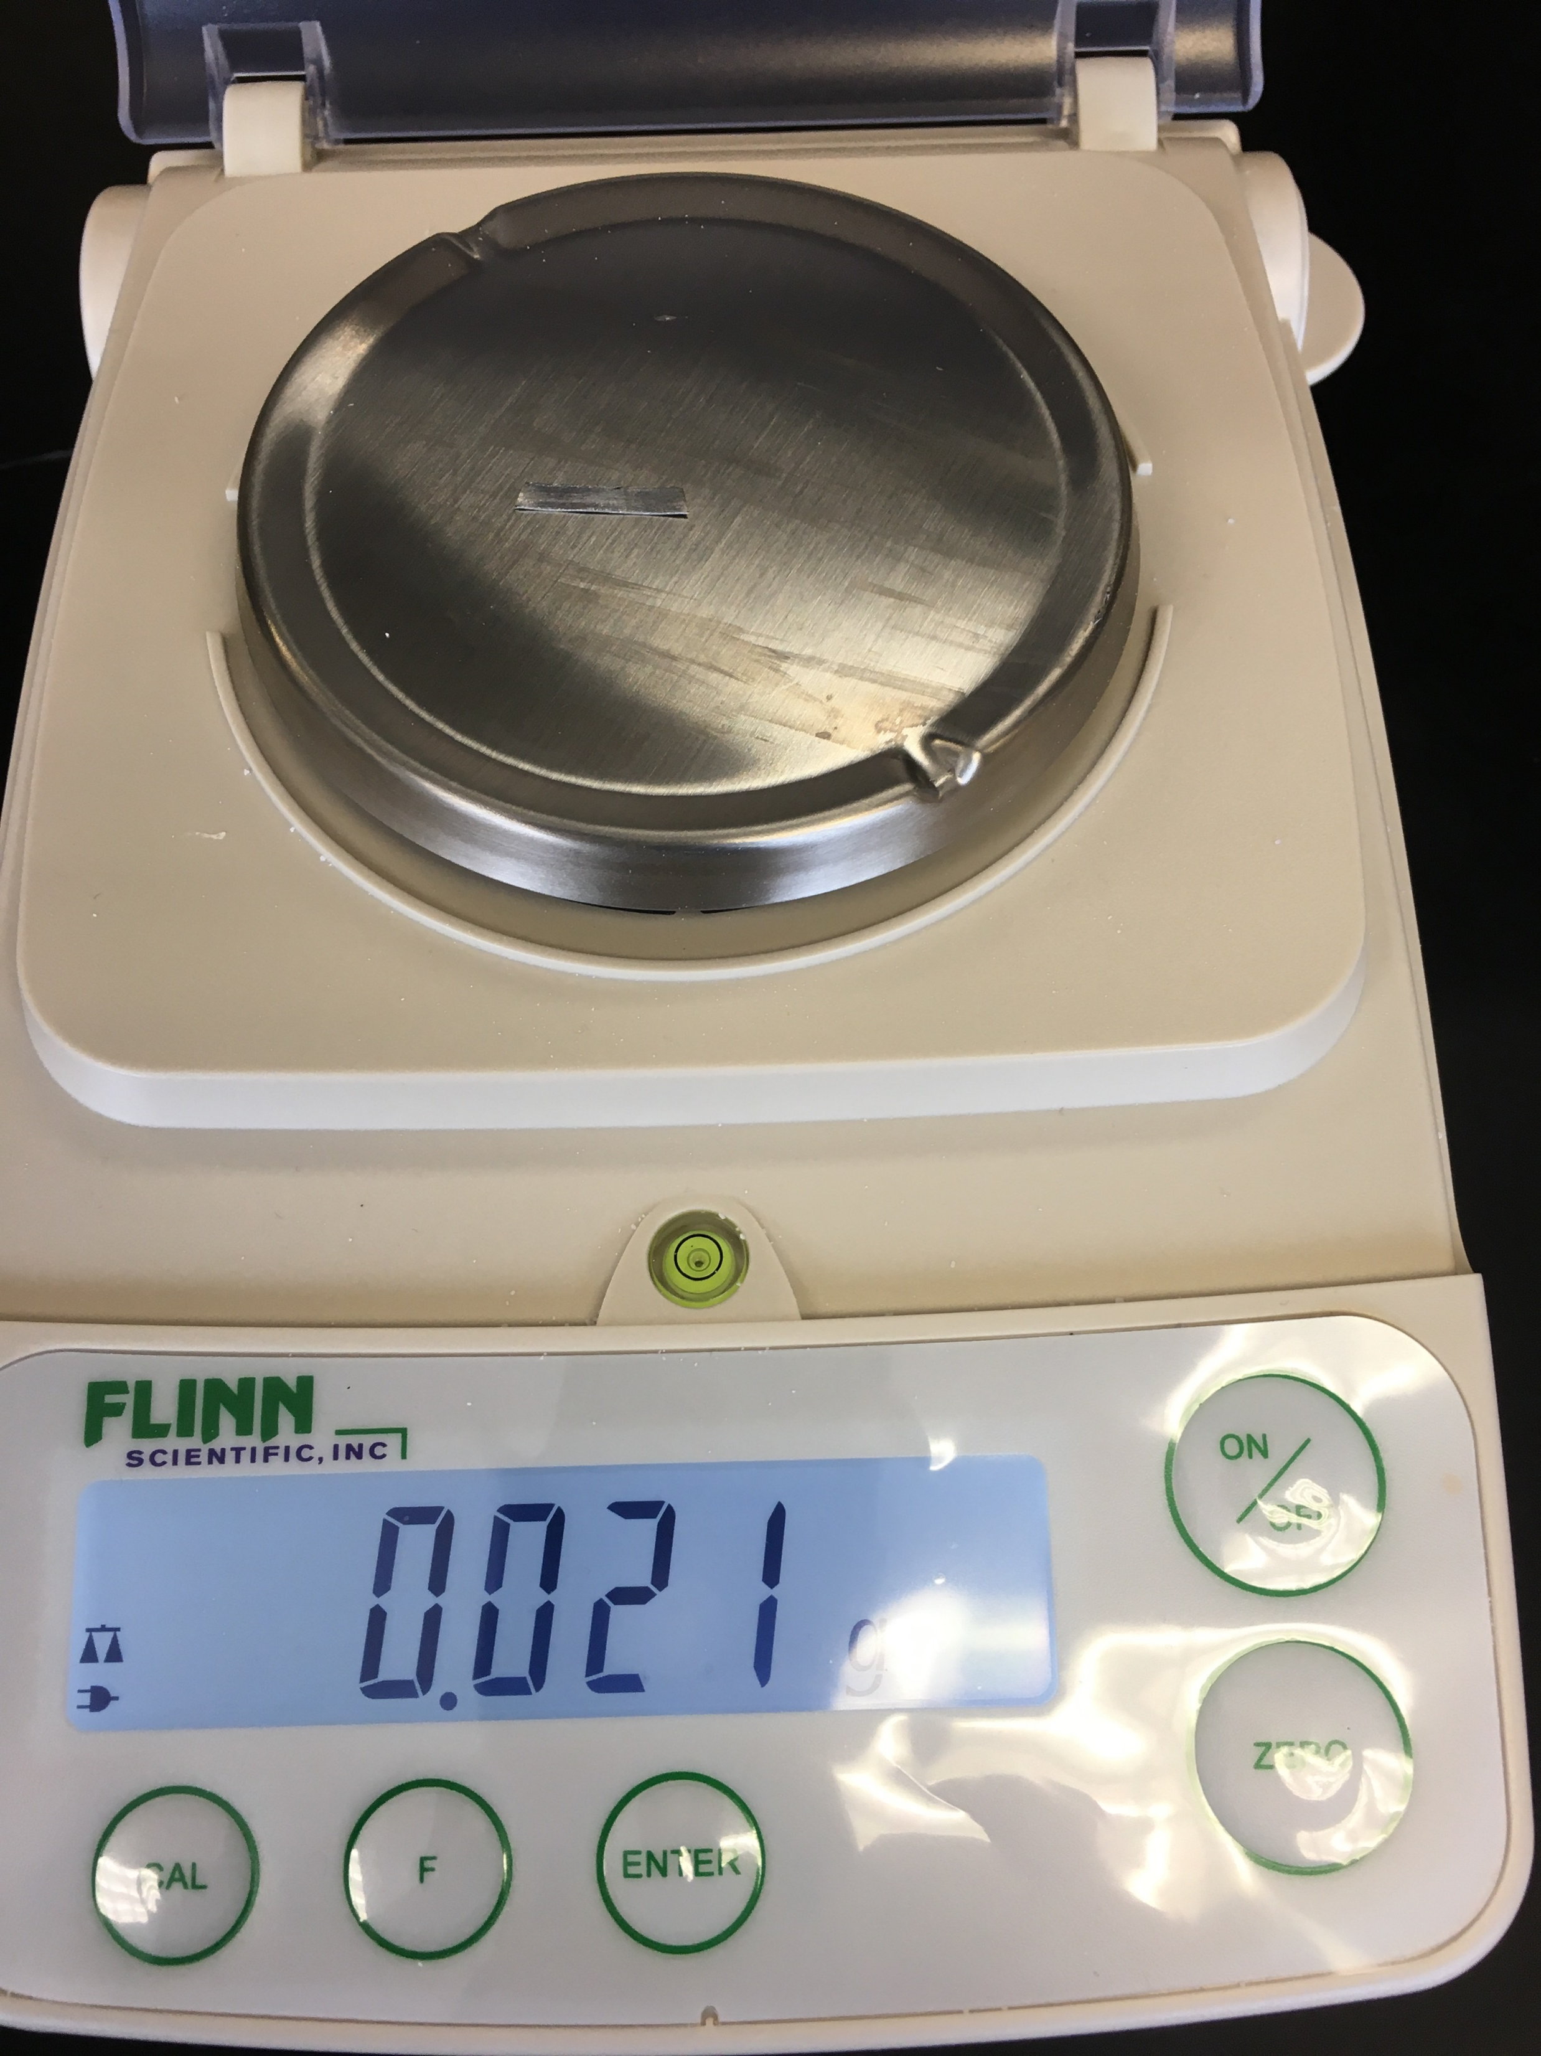
Record mass of Mg on report sheet

Slide 7
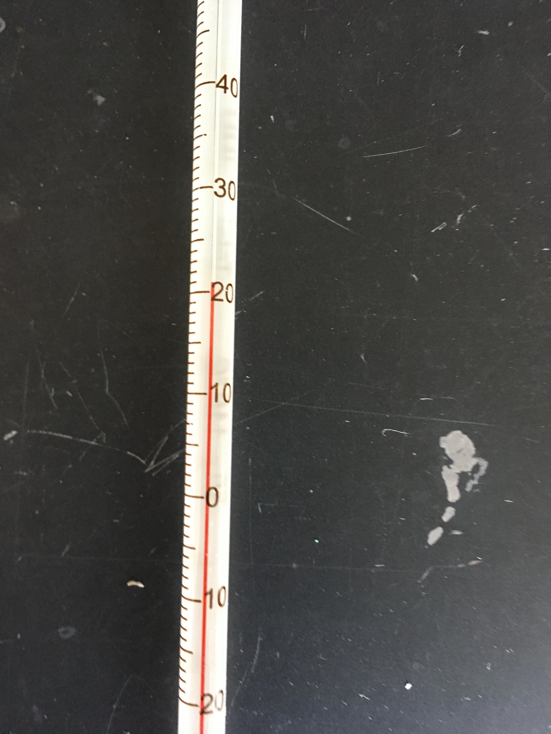
Record the temperature of the room
Record the temperature in ºC, then convert to Kelvin temperature on your lab report worksheet

Slide 8
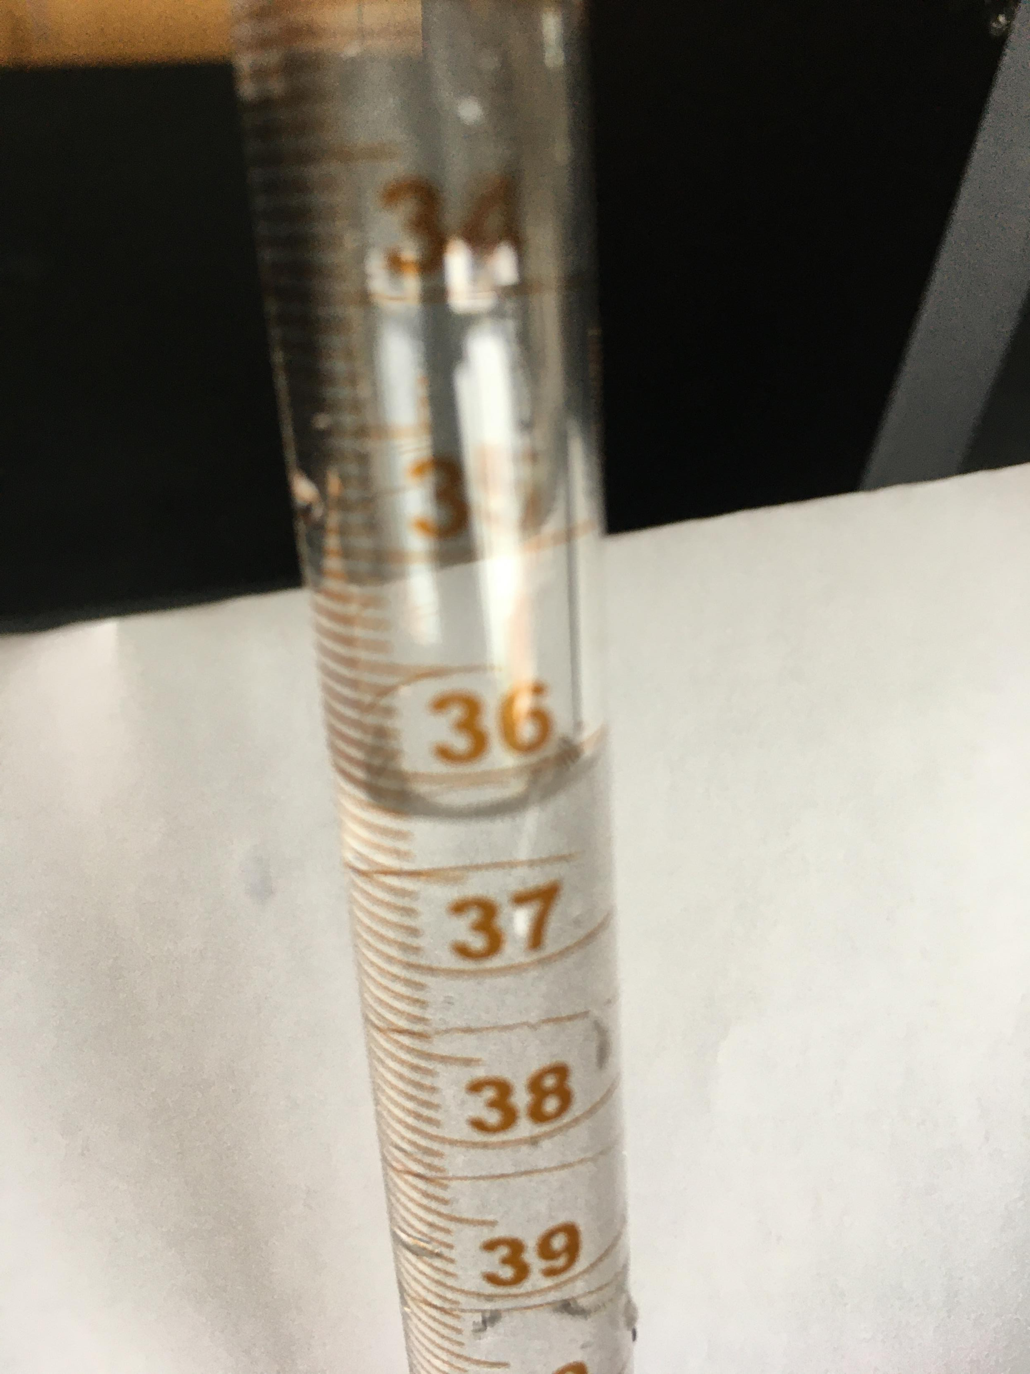
Record the volume of gas collected in the eudiometer
Read measurement with correct sig, fig and record on lab report worksheet.

Slide 9
Calculation #1 – moles of H₂
Use the g of Mg from data table , do stoichiometry to calculate the moles of hydrogen gas.

Slide 10

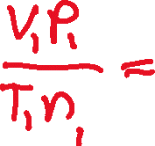


Calculate Molar volume (V₂) using the combined gas law
Use data from data table
V₁= volume in eudiometer V₂= ?????
P₁= pressure in room P₂= SP = 760 mm Hg
T₁= temperature in room in K T₂= ST = 273 K
N₁=moles of H2 gas (calc #1) N₂= 1 mole
Solve for V₂

Slide 11
Question #1
Think about the type of molecule (polar or non polar … look at the ends)
Then the type of Intermolecular forces (h-bond, dipole-dipole or dispersiom based on molecule type)

Slide 12

Question #2
Use the Ideal gas law and solve using the provided data
Choose R so units cancel

